Slide 1
Virtual Machine on AWS Consloe with Ubuntu OS

Slide 2
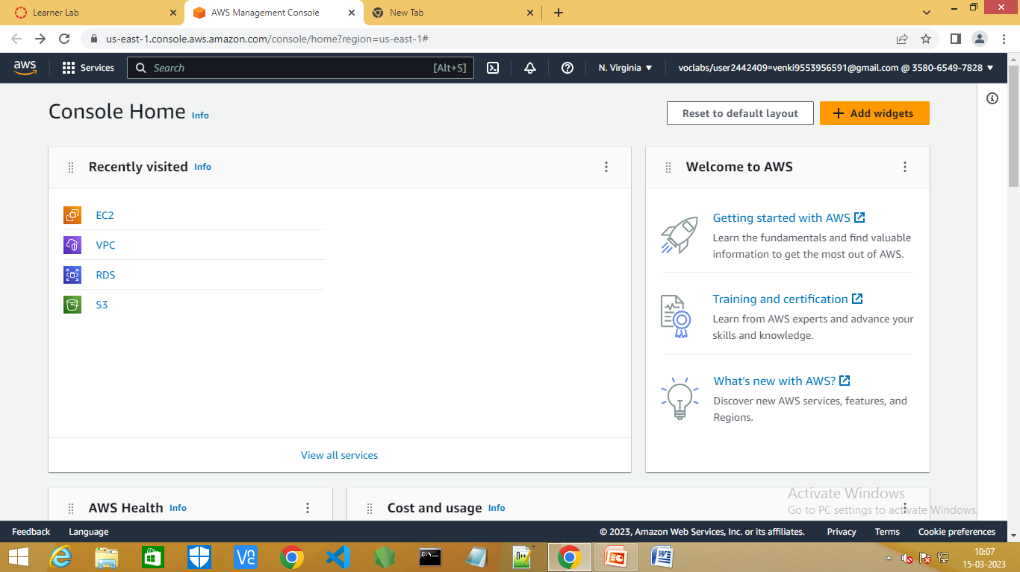
Step1:Go to the AWS Console

Slide 3
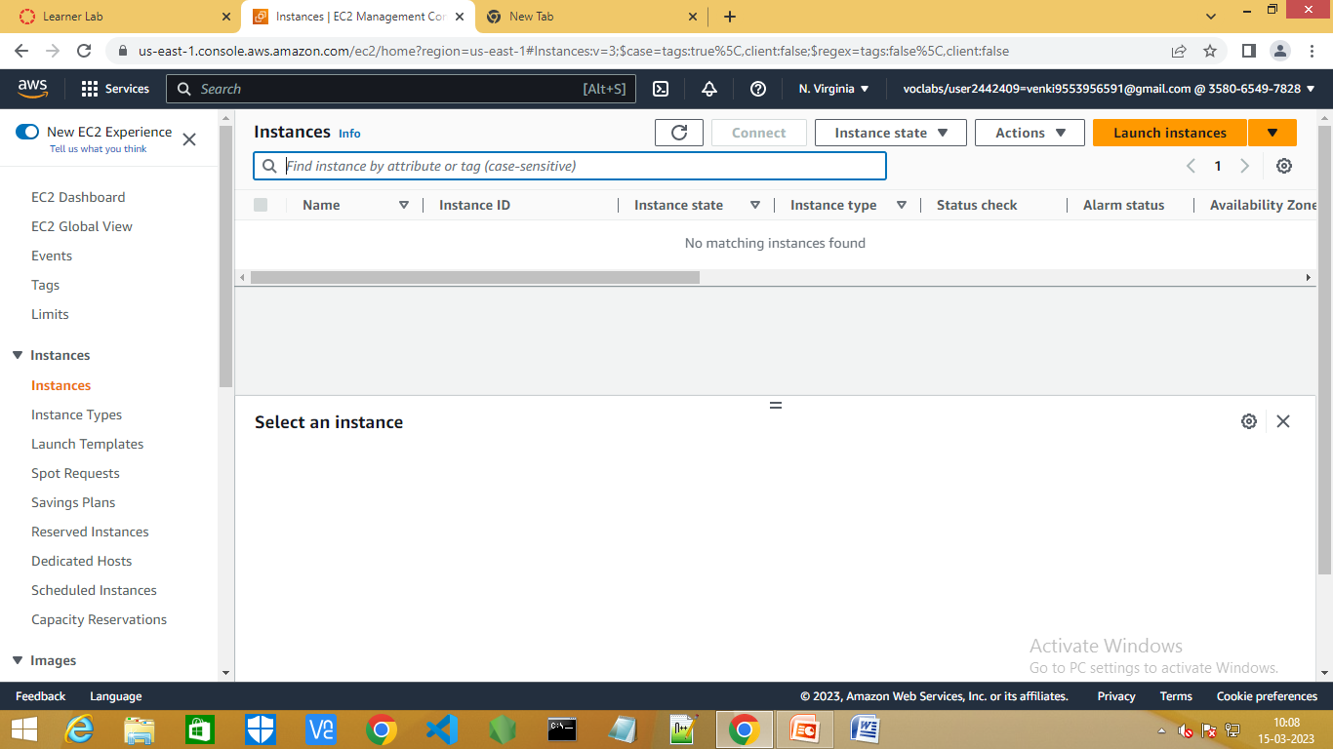
Step2:Now search for EC2 and click on instances

Slide 4
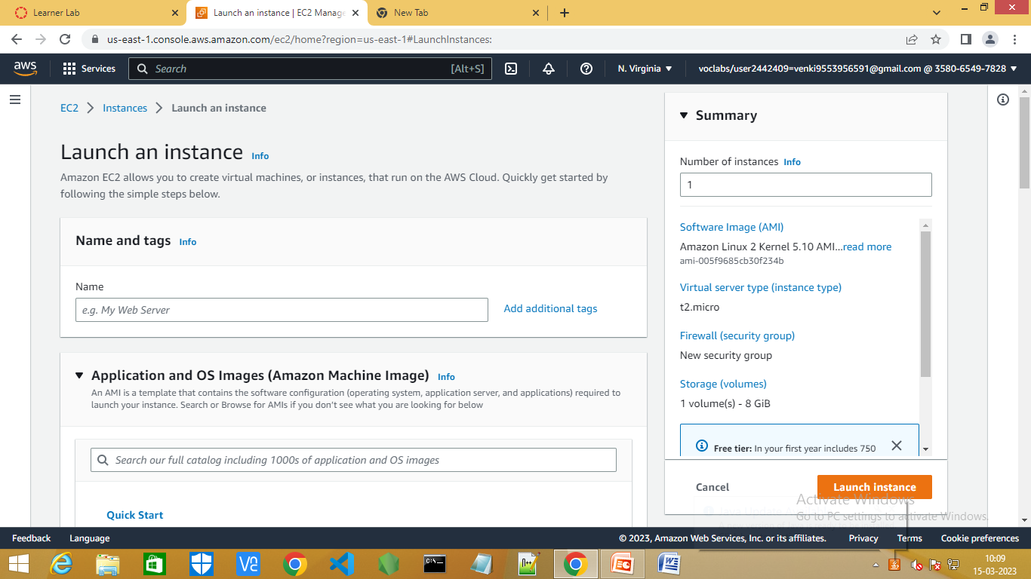
Step3:click on launch instances

Slide 5
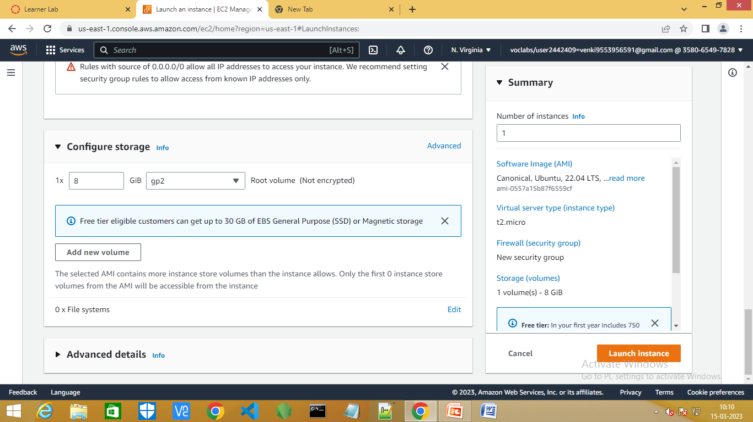
Step4:Now fill the contents and click on launch instances.

Slide 6
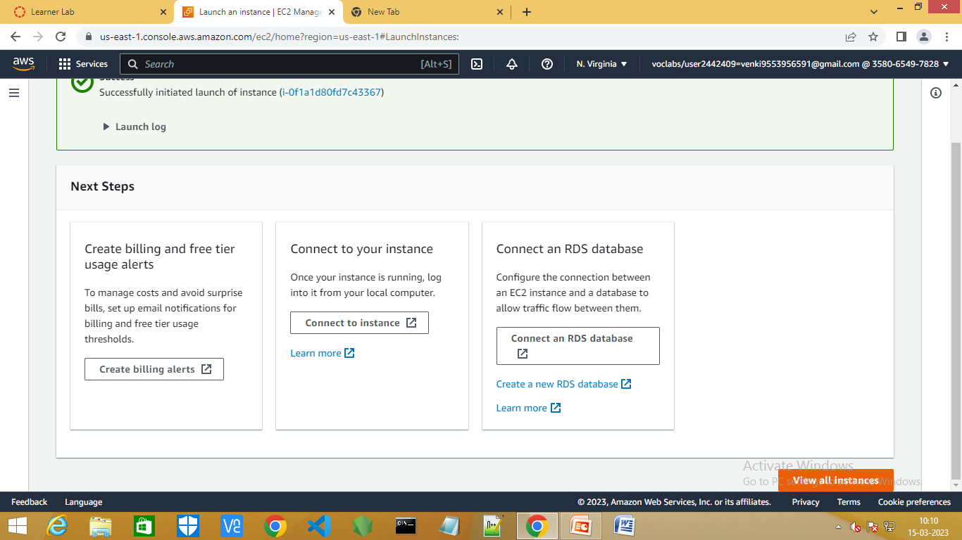
Step5:Now click on view all instances.

Slide 7
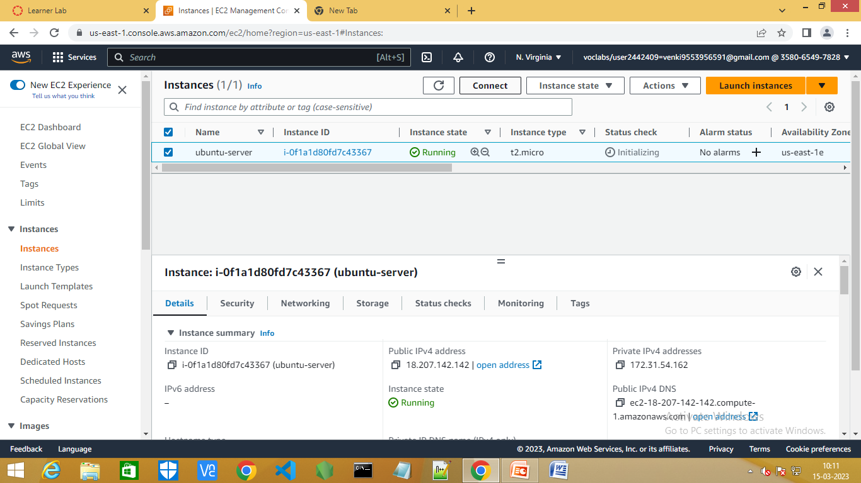
Step6:Select the ubuntu-serever instance and click on connect.

Slide 8
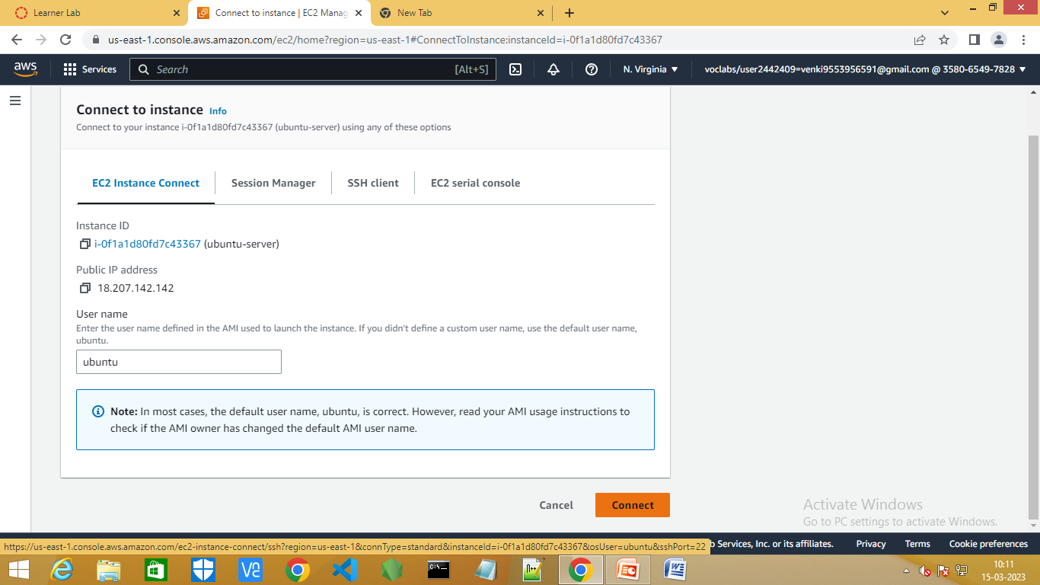
Step7:Now,select EC2 instance conect and click on connect.

Slide 9
List of Commands
Commands:
sudo su –
apt-get update –y
apt-get install apache2 -y

Slide 10
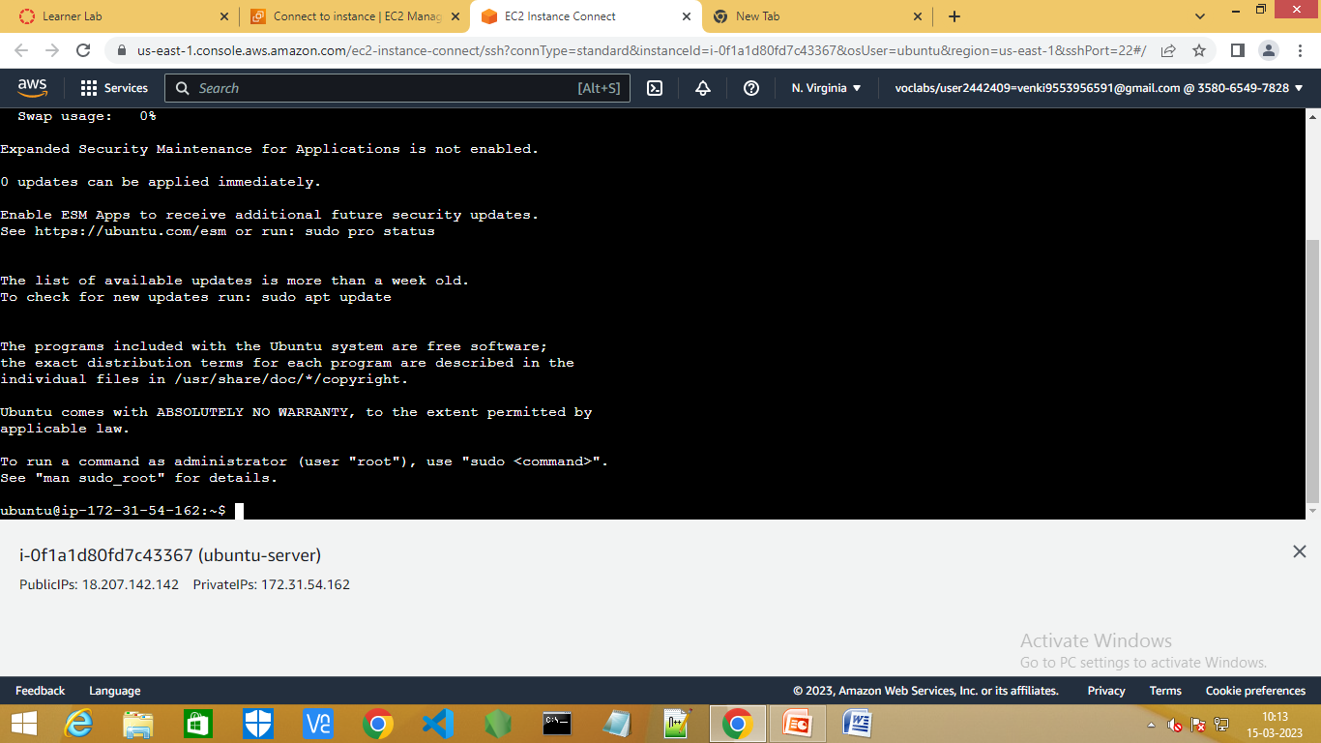
Step8:It loads the EC2 console and type the above commands.

Slide 11
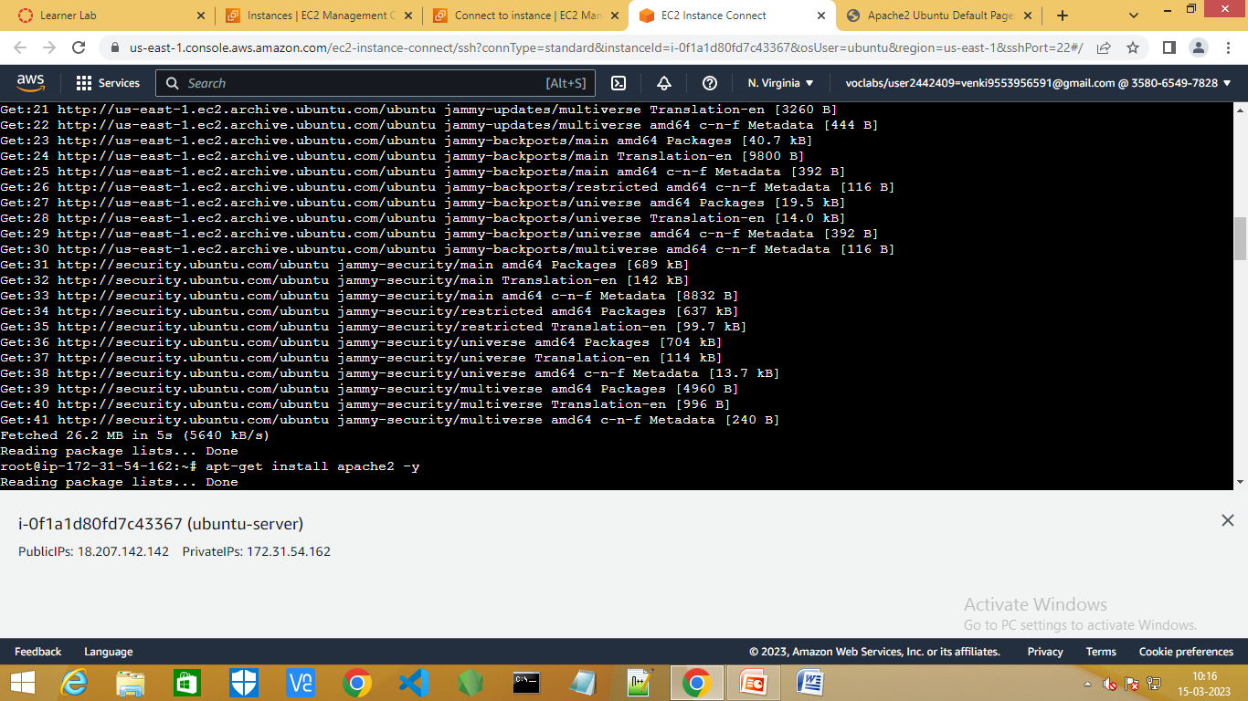

Slide 12
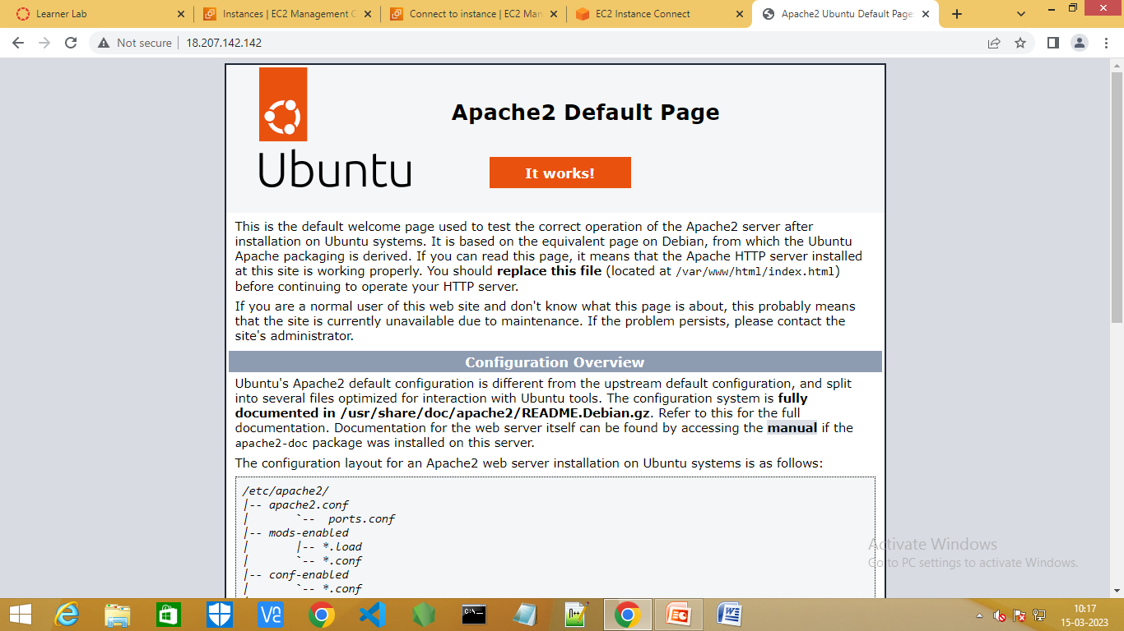
Step8:Now copy the public ipv4 address and paste in a new window.

